Slide 1
Lesson 1 - Introduction
Special Thanks
Nakib Hayat Chowdhury
Md. Muktar Hossain
Lecturer
Dept. of Computer Science and Engineering
Varendra University

Slide 2
In this Class
Structured Programming Language
Why C is Structured Programming Language
Importance of C
Features of C
How to develop a program
Algorithm
Flow Chart
History of Programming Language
Translator

Slide 3
Structured Programming Language
Structured programming, or modular programming, is a programming paradigm that facilitates the creation of programs with readable code and reusable components.
Structured programming is a programming paradigm aimed at improving the clarity, quality, and development time of a computer program by making extensive use of structured control flow constructs like sequences, loops, and conditionals. This paradigm emphasizes the use of modular design and clear, understandable code.

Slide 4
“C is Structured Programming Language”
Modularity: C allows programmers to break down a program into smaller, manageable pieces called functions. Each function performs a specific task, and these functions can be reused throughout the program. This promotes code reuse and makes the program easier to understand and maintain.
Structured Control Flow: C provides constructs for structured control flow, such as loops (like for, while, and do-while loops) and conditionals (like if-else statements). These constructs enable programmers to control the flow of execution in a clear and structured manner.

Slide 5
“C is Structured Programming Language”
Clear Syntax: C has a simple and concise syntax that promotes readability and maintainability. Its syntax closely resembles the logical structure of algorithms, making it easier for programmers to express their ideas in code.
Procedural Approach: C follows a procedural programming paradigm, where the program is organized as a series of procedures (functions) that operate on data. This approach emphasizes step-by-step procedure execution, making it easier to understand and debug programs.
Overall, C's support for modularity, structured control flow, clear syntax, and procedural approach align it closely with the principles of structured programming, making it an ideal language for writing structured, maintainable, and efficient code.

Slide 6
Why C?
Operating System (OS)
Embedded System (ES)
Microcontroller based programming (Robotics)
System Programming
Programming Language Development
Game Engine
Programming Contest

Slide 7
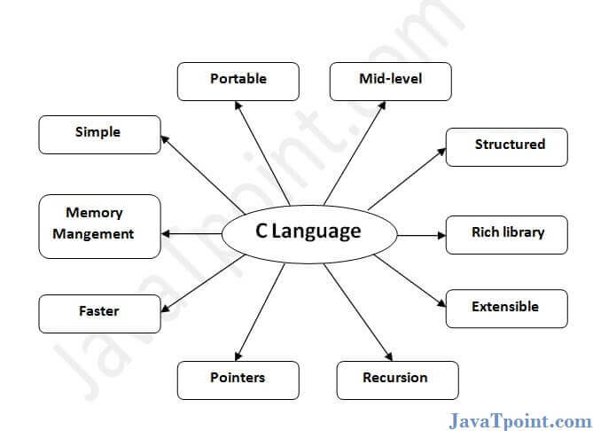
Features of C Language

Slide 8
How to Develop a Program
Step 1: Analyze the program to identify inputs, outputs and processing requirements.
Step 2: Identify various processing steps needed to solve the problem.
Step 3: Refine Step 2
Step 4: Add the syntax of the programming language
Step 5: Run the program and check it with different types of input to verify its correctness.

Slide 9
Algorithm
It is a complete step by step representation of the solution of the problem, represented in English like language.
An algorithm can be quite abstract or quite detailed.
Algorithm
1. Start
2. Read n1. 3. Read n2. 4. Calculate Sum = n1 + n2. 5. Write the sum. 6. Stop.

Slide 10
Flow Chart
Very popular method to represent the steps of the solution.
Uses many graphical symbols and thus, is more understandable.
The symbols used for various different types of statements/steps.

Slide 11
Flow Chart
Start
Very popular method to represent the steps of the solution.
Uses many graphical symbols and thus, is more understandable.
The symbols used for various different types of statements/steps.
Read n1
Read n2
Sum = n1 + n2
Print Sum
Stop

Slide 12
Flowchart Symbols
oval
Beginning or end of program
START
Parallelogram
Input or Output
Read n
or
Print n
Direction of logic flow

Slide 13
Flowchart Symbols
Rectangular
Processing
Sum = a+b
Diamond
Decision
If x>10 ?
Connector

Slide 14
Write a program to add two numbers
Start
Read n1
Read n2
Algorithm
1. Start
2. Read n1. 3. Read n2. 4. Calculate Sum = n1 + n2. 5. Write the sum. 6. Stop.
Sum = n1 + n2
Print Sum
Stop

Slide 15
Write a program to find bigger one between two numbers
Start
Read n1
Read n2
Algorithm
1. Start
2. Read n1. 3. Read n2. 4. If n1>n2.
print n1 is bigger
5. else
print n2 is bigger 6. Stop.
Yes
No
if
n1 > n2
?
Print n1
Print n2
Stop

Slide 16
Write a program to Find Sum of first n numbers
Start
Read n
Algorithm
1. Read n. 2. Initialize i=1. 3. Initialize sum, Sum=0. 4. Calculate, Sum = Sum+i. 5. Calculate, i = i+1. 6. If i>n, then goto step 7 else goto step 4. 7. Write the sum Sum. 8. Stop.
i = 1
Sum = 0
Sum = Sum + i
i = i+1
No
If i > n?
Yes
Print sum
Stop

Slide 17
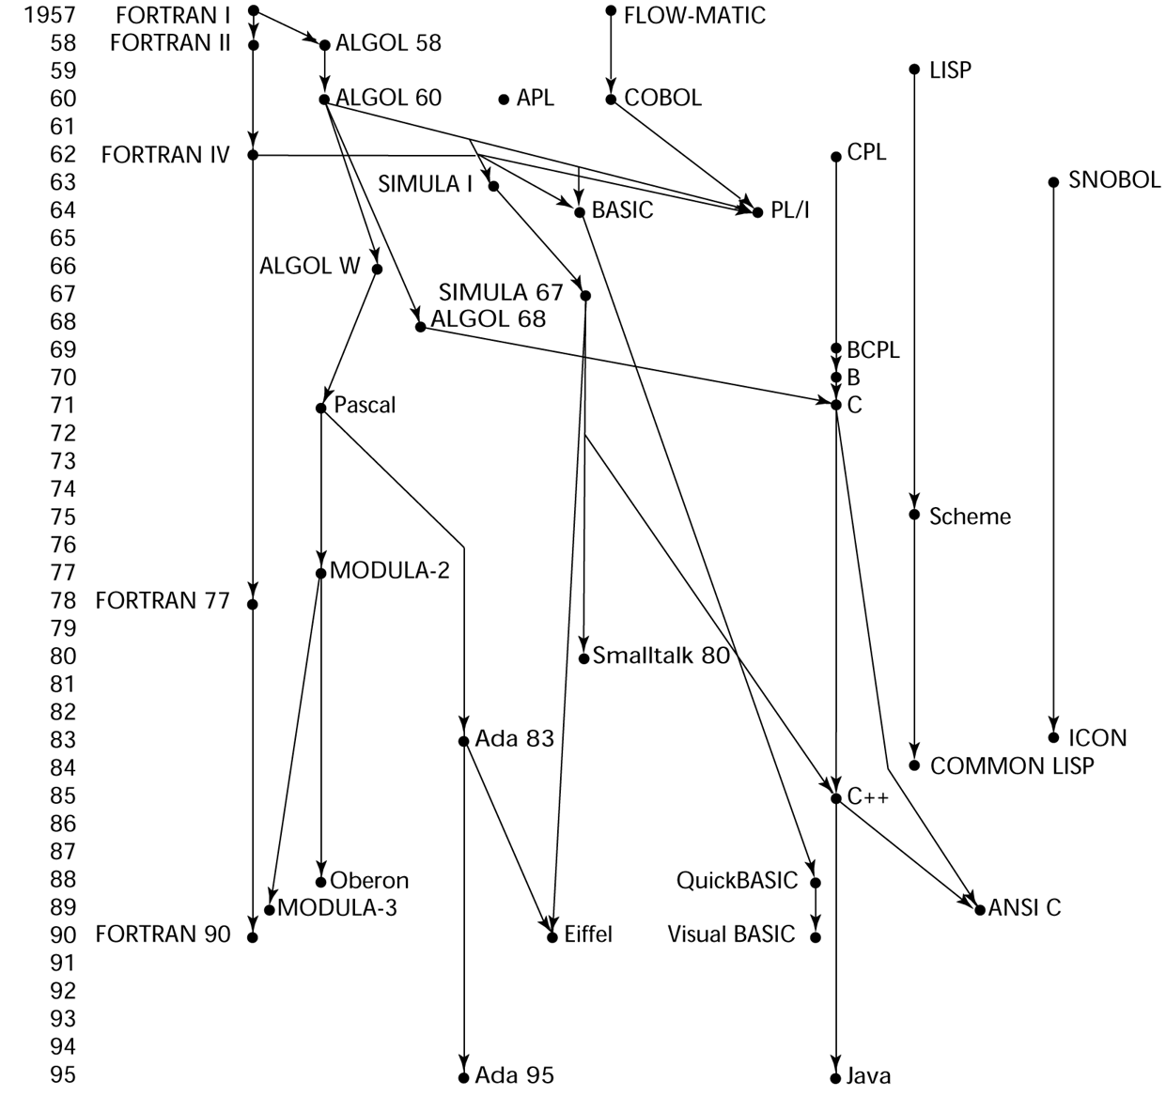
History of Programming Language

Slide 18
Computer Programming
Computer programming is the process of designing, writing, testing, debugging and maintaining the source code of computer programs.
This source code is written in one or more programming languages (such as C++, C#, Java, Python, Smalltalk, etc.).

Slide 19
Type of Programming Language
Machine languages
Assembly languages
Higher-level languages

Slide 20
Machine Languages
Machine languages (first-generation languages) are the most basic type of computer languages, consisting of strings of numbers the computer's hardware can use.
Different types of hardware use different machine code. For example, IBM computers use different machine language than Apple computers

Slide 21
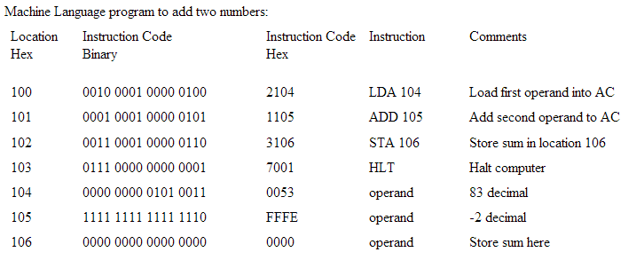
Machine Languages : 83+(-2)

Slide 22
Machine Languages : 83+(-2)

Slide 23
Assembly Languages
Assembly languages (second-generation languages) are only somewhat easier to work with than machine languages.
To create programs in assembly language, developers use cryptic English-like phrases to represent strings of numbers.
The code is then translated into object code, using a translator called an assembler.

Slide 24
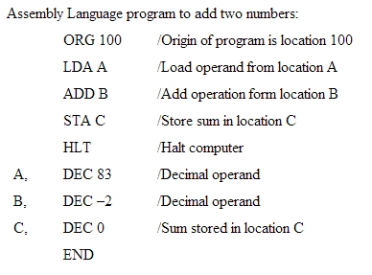
Assembly Languages : 83+(-2)

Slide 25
Assembly Languages : 83+(-2)

Slide 26
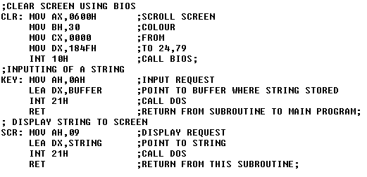
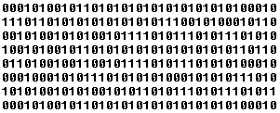
Assembly
code
Assembler
Object code

Slide 27
Higher-Level Languages
Higher-level languages are more powerful than assembly language and allow the programmer to work in a more English-like environment.
Higher-level programming languages are divided into three "generations," each more powerful than the last:
Third-generation languages
Fourth-generation languages
Fifth-generation languages

Slide 28
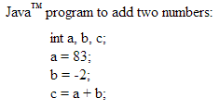
High Level Language : 83+(-2)

Slide 29
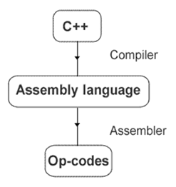

Slide 30
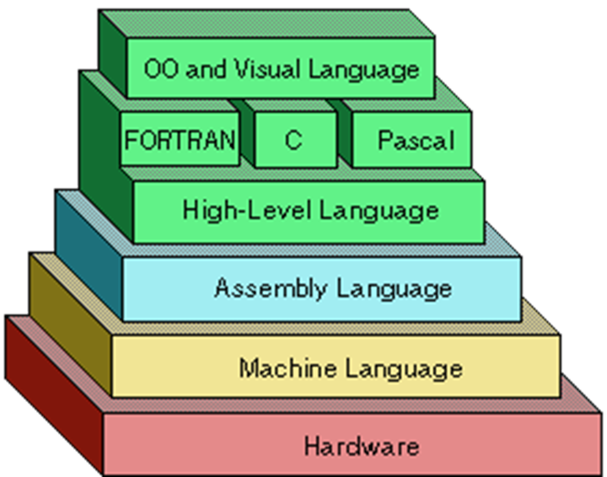

Slide 31
Translator
Translators are just computer programs which accept a program written in high level or low level language and produce an equivalent machine level program as output. Translators are of three types:
Assembler
Compiler
Interpreter

Slide 32
Assembler
Assembler is used for converting the code of low level language (assembly language) into machine level language.

Slide 33
Compiler
The compiler is one kind of system software that translates the programs written in high level language to machine language.

Slide 34
Interpreter
The interpreter is a system software which use to convert high level language programs to machine language. But it convert one line at a time and execute it then it convert next line and so on.

Slide 35
Compiler vs Interpreter
A complier converts the high level instruction into machine language while an interpreter converts the high level instruction into an intermediate form.
The compiler executes the entire program at a time, but the interpreter executes each and every line individually.
List of errors is created by the compiler after the compilation process while an interpreter stops translating after the first error.
Autonomous executable file is generated by the compiler while interpreter is compulsory for an interpreter program.
Interpreter is smaller and simpler than compiler
Interpreter is slower than compiler.

Slide 36
Thank You

